Slide 2
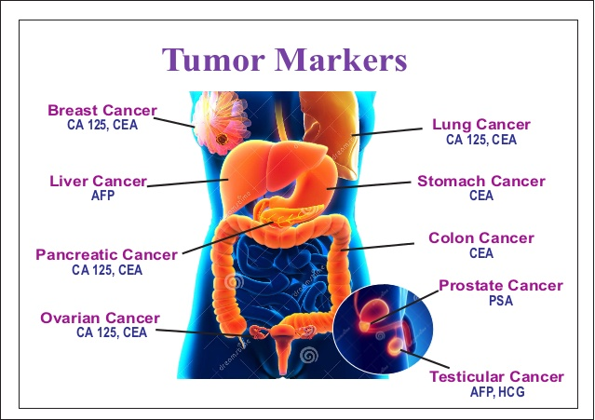
(Alpha Feto Protein)
Why Are Biomarkers Important?
Early Detection: Identifies cancers before symptoms arise.
Personalized Treatment: Helps tailor therapies based on specific marker profiles. Monitoring Treatment Response: Tracks the effectiveness of interventions. Prognosis Prediction: Provides insights into disease progression and survival.

Slide 4
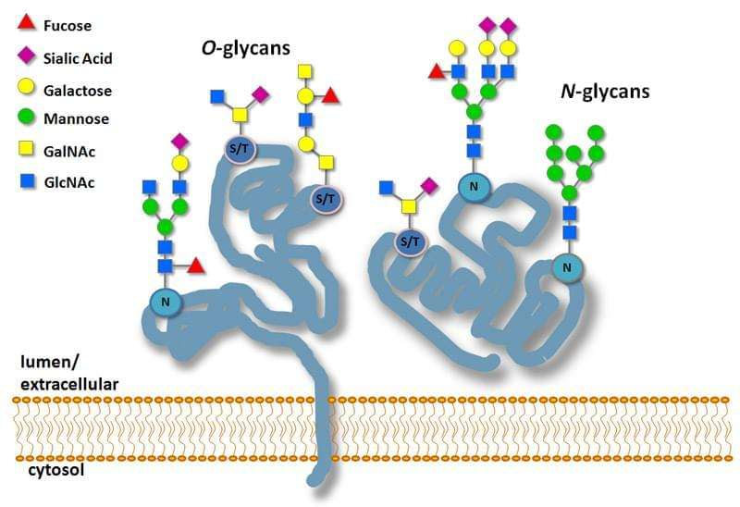
Glycoproteins can be membrane bound or secreted

Slide 5
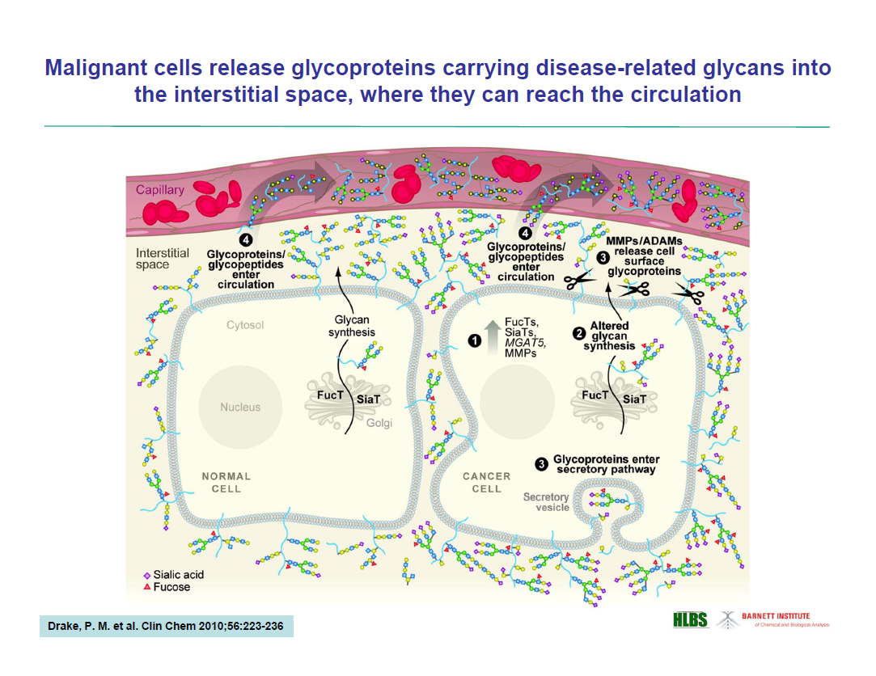

Slide 6
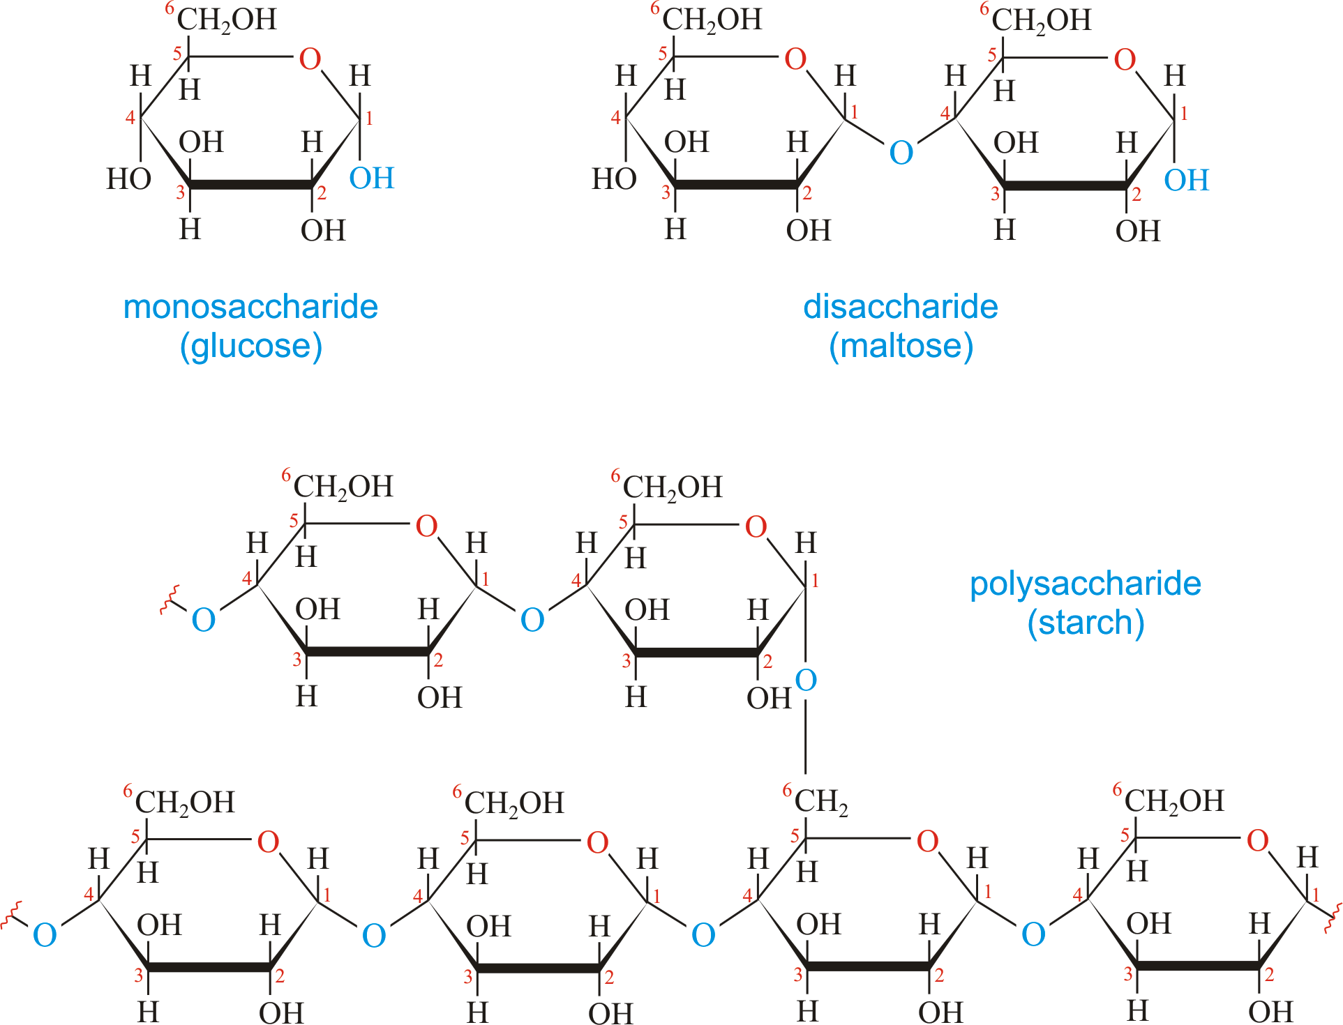
Glycosidic Linkage
(α 1-4 linkage)
(α 1-6 linkage)

Slide 7
Lectins
Lectins are carbohydrate-binding proteins that are highly specific for sugar groups of other molecules. Lectins have a role in recognition on the cellular and molecular level and play numerous roles in biological recognition phenomena involving cells, carbohydrates, and proteins.^{[1][2]} Lectins also mediate attachment and binding of bacteria and viruses to their intended targets.
Lectins are ubiquitous in nature and are found in many foods. Some foods such as beans and grains need to be cooked or fermented to reduce lectin content. Some lectins are beneficial, such as CLEC11A, which promotes bone growth, while others may be powerful toxins such as ricin.^{[3]}
Lectins may be disabled by specific mono- and oligosaccharides, which bind to ingested lectins from grains, legumes, nightshade plants, and dairy; binding can prevent their attachment to the carbohydrates within the cell membrane.^{[4]} The selectivity of lectins means that they are useful for analyzing blood type, and they have been researched for potential use in genetically engineered crops to transfer pest resistance.

Slide 8
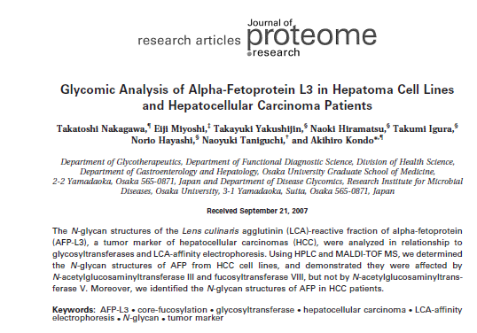
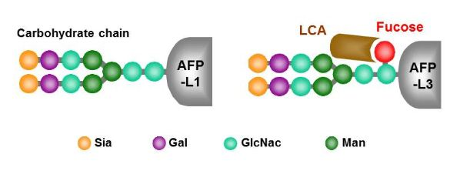
Lens culinaris (lectin)
(α1-6 linkage)

Slide 9
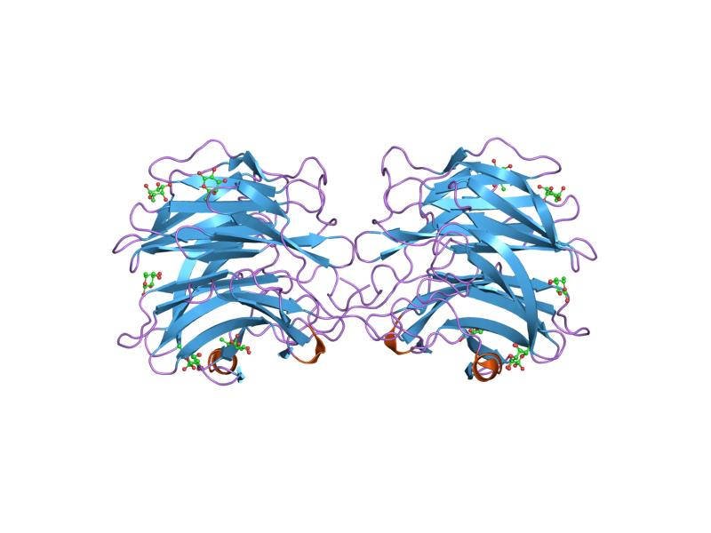
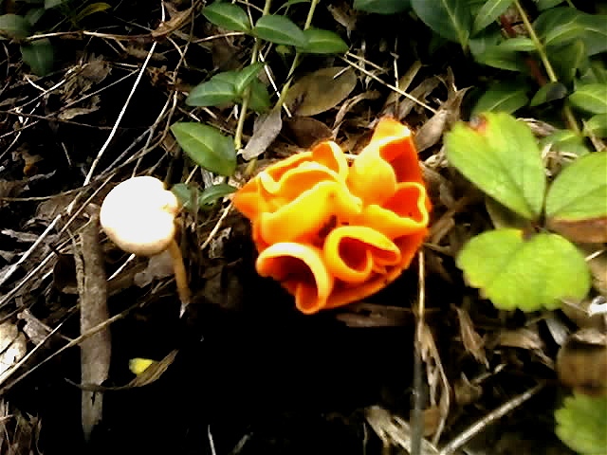
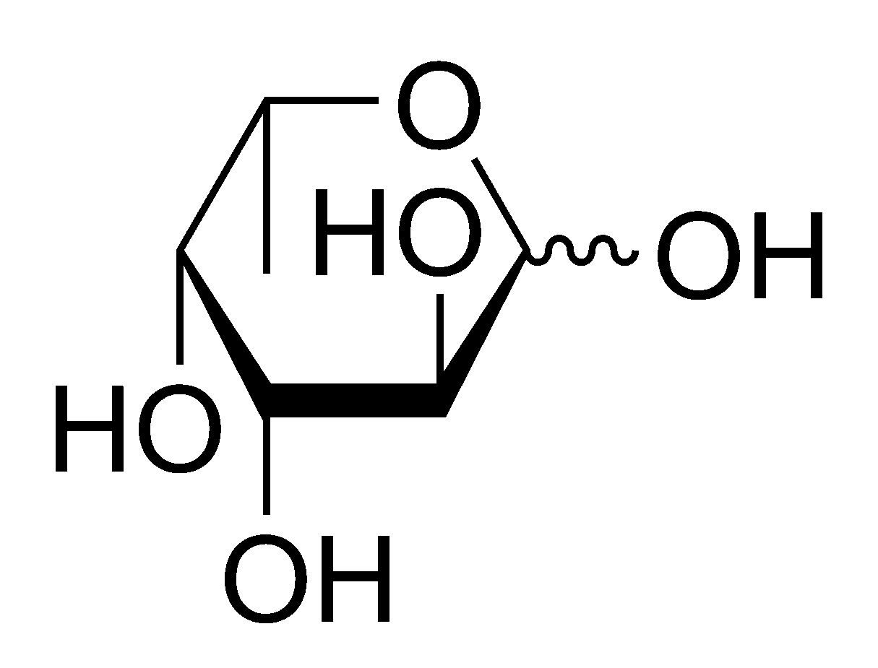
Production of Recombinant Lectins
for Research and Diagnostic Use
Aleuria aurantia (AAL)
fucose binding lectin
L-Fucose (6-Deoxy-L-galactose)
The Aleuria aurantia lectin (AAL) derived from orange peel fungus contains five fucose-binding sites that recognizes fucose bound in
α-1,2, α-1,3, α-1,4, and α-1,6 linkages to N-acetylglucosamine and galactose.

Slide 10
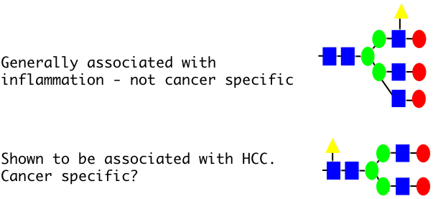
The lack of fucopyranosyl linkage specificity in native AAL is problematic for detecting AFP-L3
Outer arm fucosylation (α1-3 linkage)
Asn
Asn
Fucose
Core fucosylation (α1-6 linkage)
N-Acetylglucosamine(GlcNAc)
AFP-L3
Mannose
Galactose

Slide 11
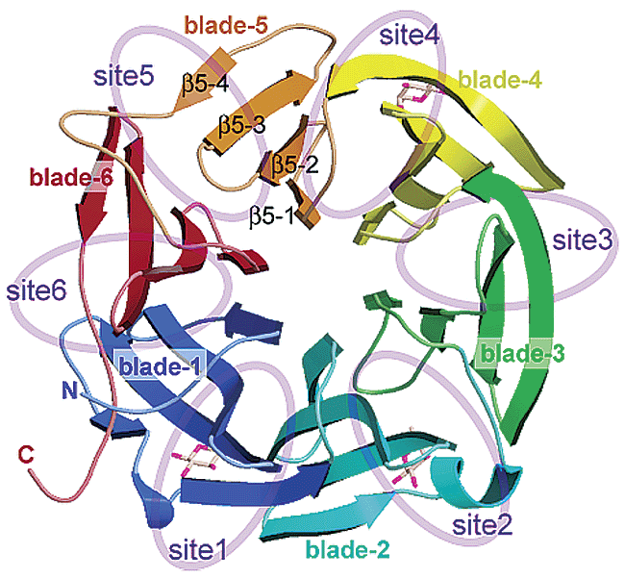
Site-directed mutagenesis approach toward creating fucopyranosyl linkage specific rAALs
Overall structure of the AAL monomer. Blue, cyan, green, yellow, orange, and red ribbons show blades 1−6, respectively. Purple ellipsoids indicate fucose binding sites 1−5 and the corresponding site 6. Three stick models at sites 1, 2, and 4 show fucose molecules

Slide 12
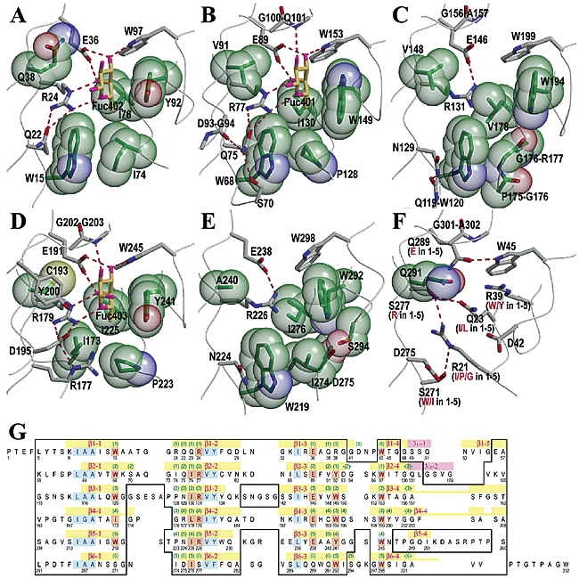
Site-directed mutagenesis approach toward creating fucopyranosyl linkage specific rAALs

Slide 13
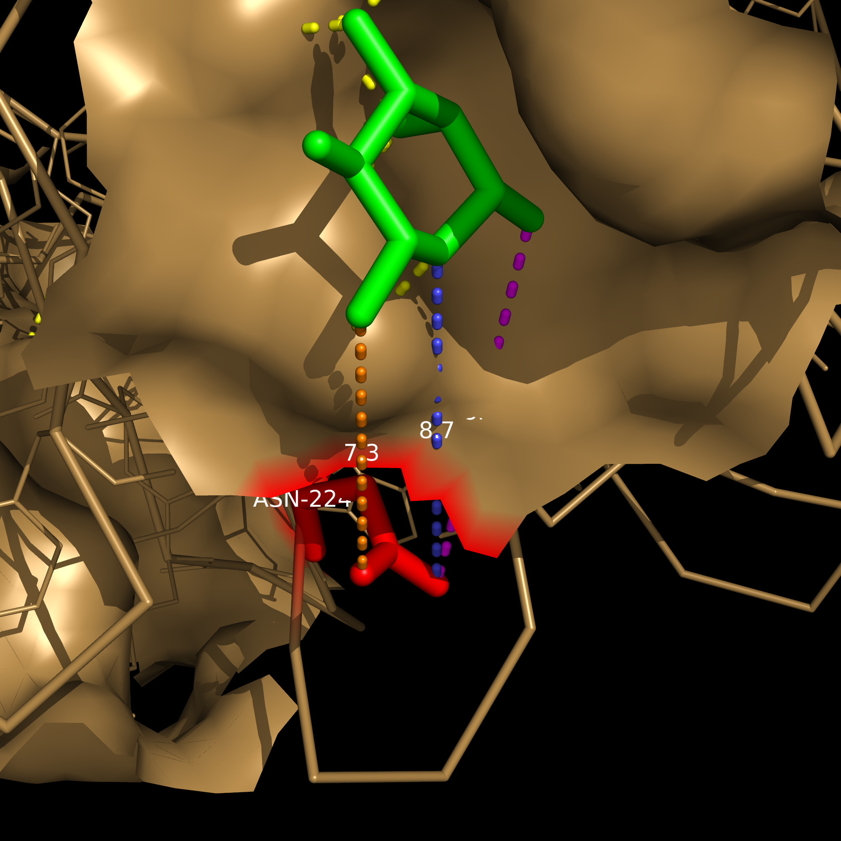
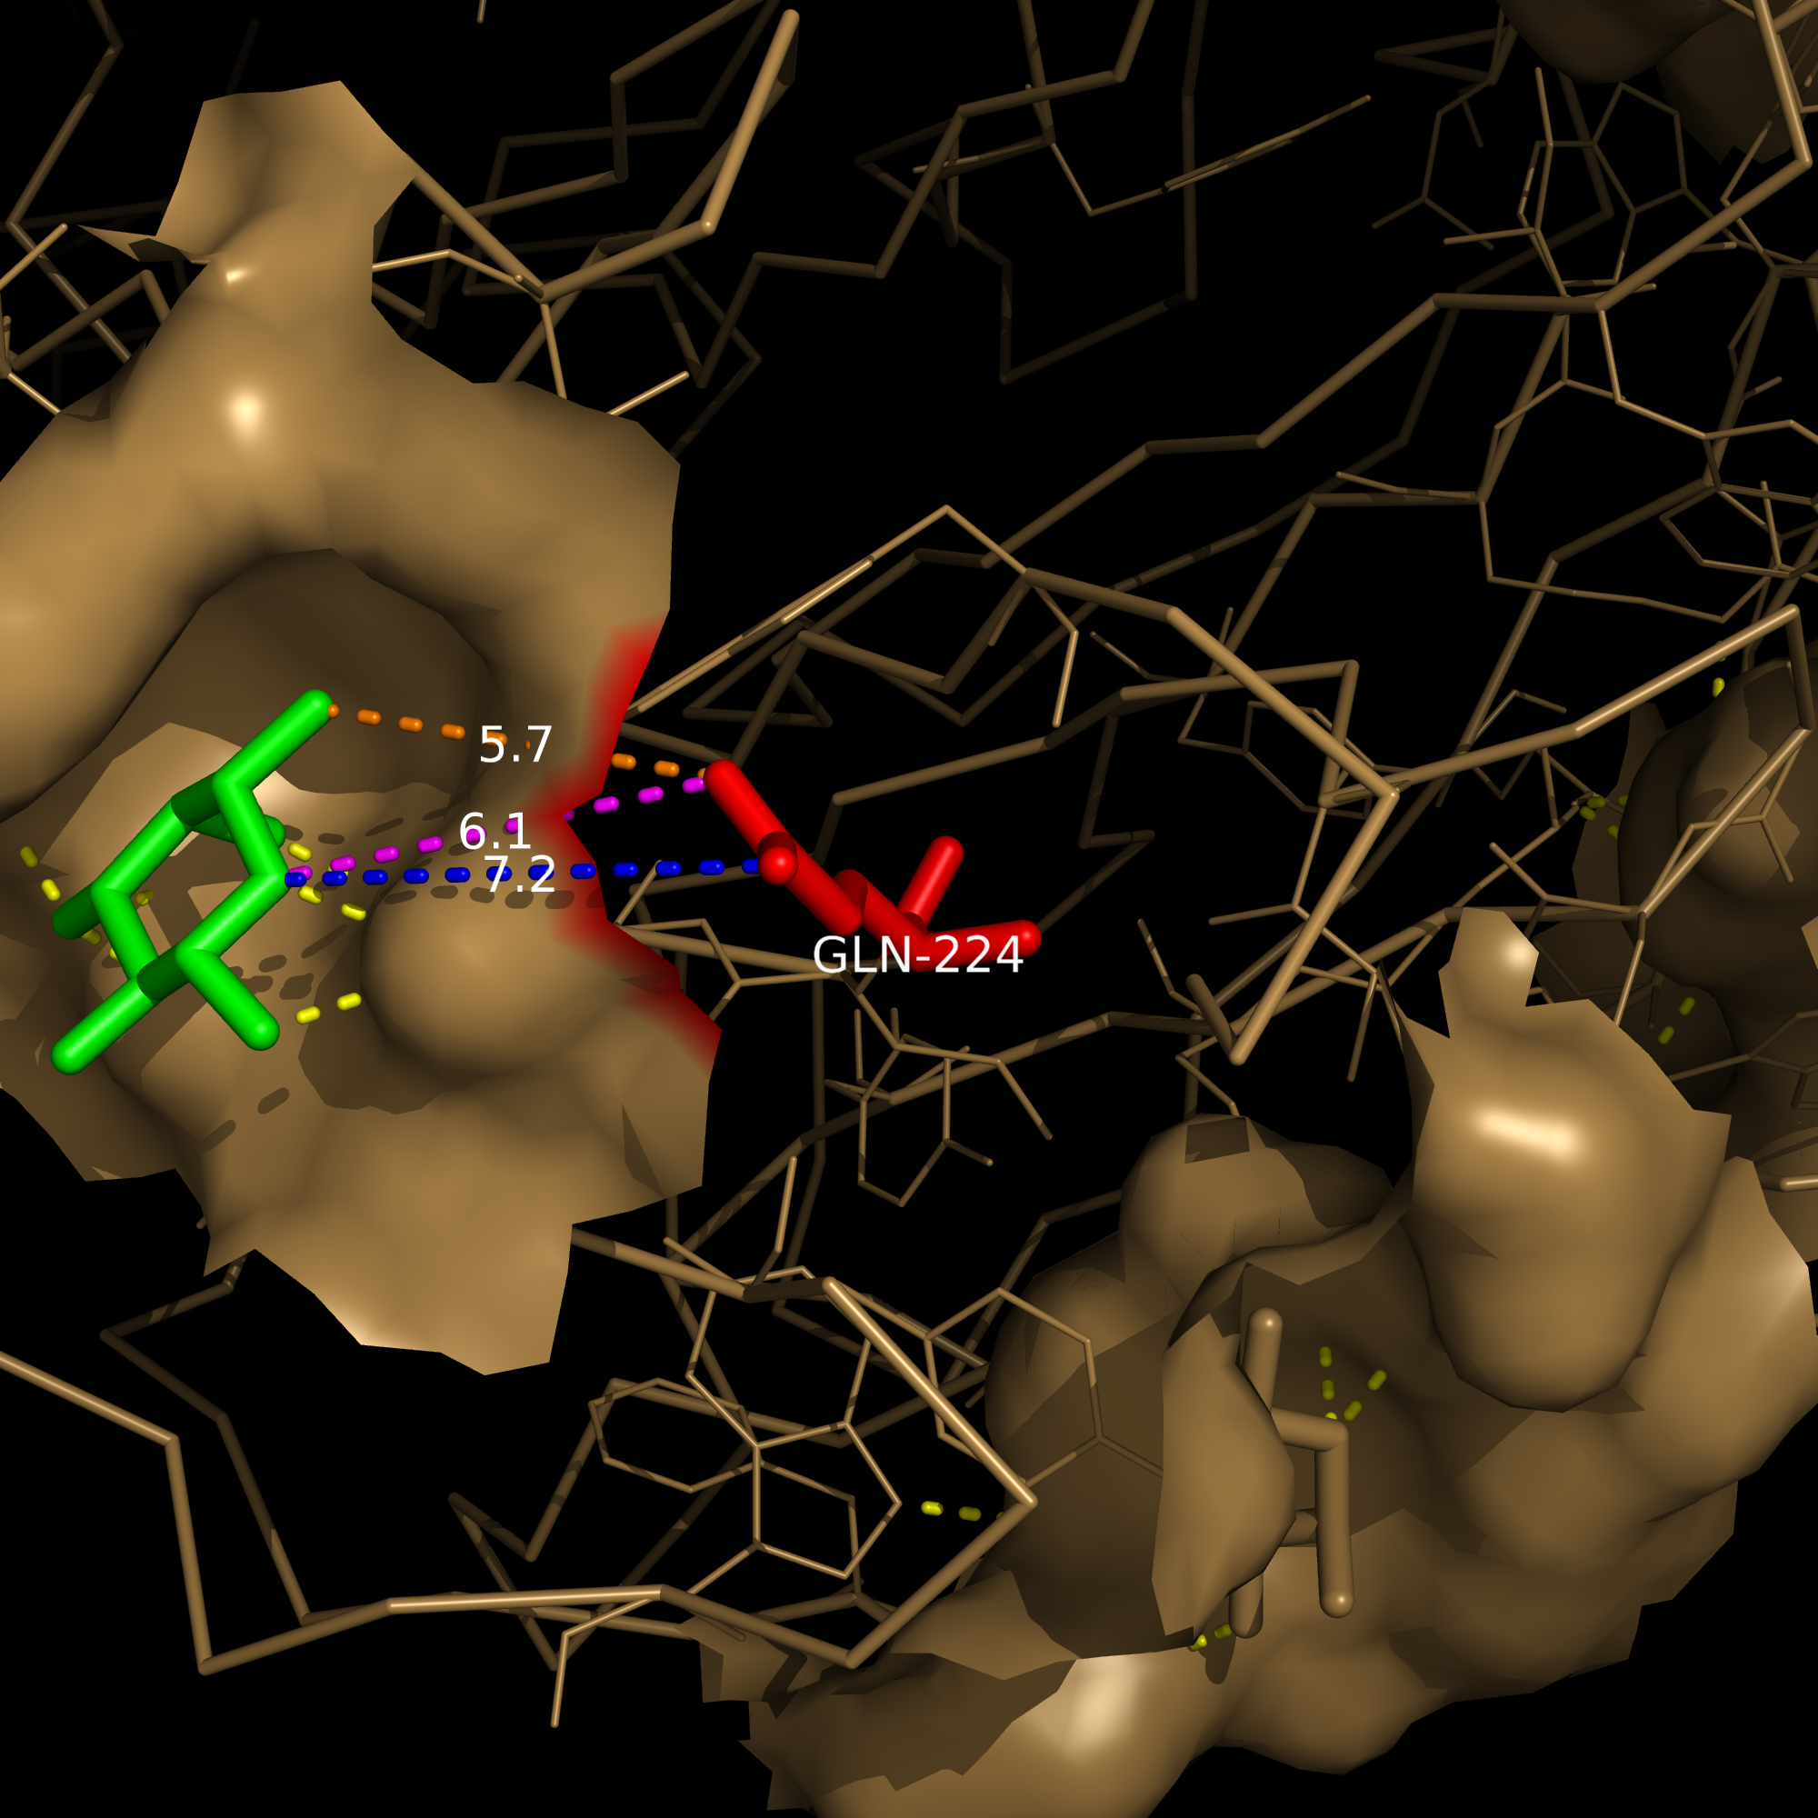
Crystal Structure AAL N224Q
Asn (N224) to nearest fucose binding site: 7.3, 8.4 and 8.7 Å (10⁻¹⁰m)
Gln (N224Q) to nearest fucose binding cleft: 5.7, 6.1 and 7.2 Å (10⁻¹⁰m)

Slide 14
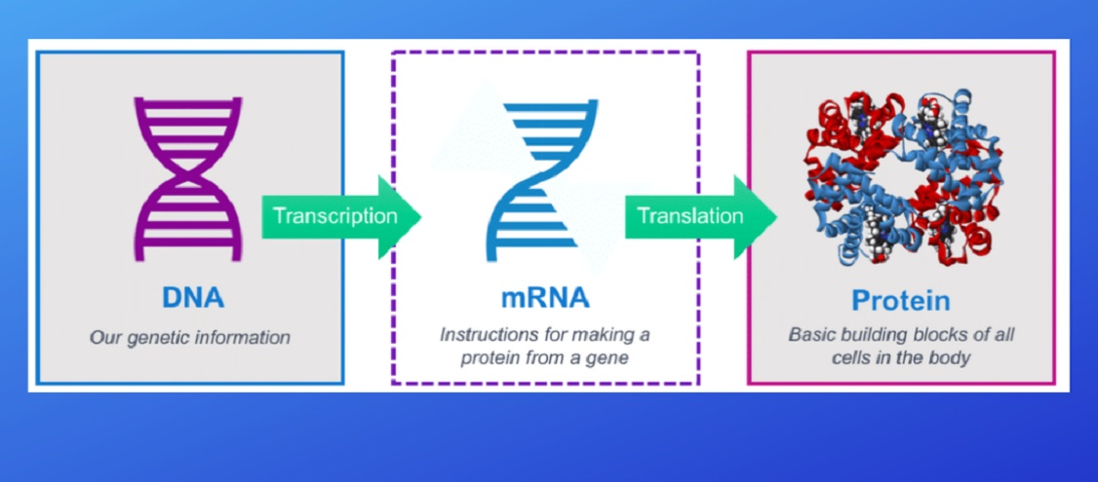
AAL Gene Expression Project
AAL gene Functional AAL protein
(DNA) (amino acid)

Slide 15
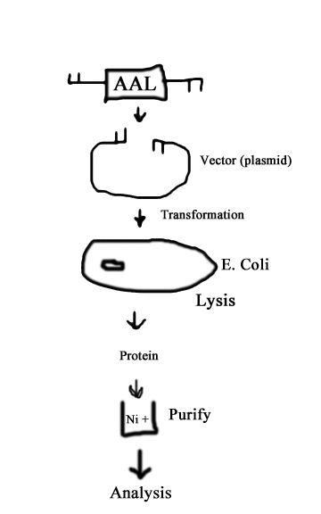
Purpose – “Gene Expression Experiment”
Biomarker glycoproteins for liver cancer are present in blood
The type of sugars on certain biomarker proteins are predictive for how advanced the disease is
With definitive markers for cancer, a simple blood test can be used for early detection of disease
The AAL protein binds to the sugar fucose which is present on certain liver cancer biomarker proteins at elevated levels
AAL can be made synthetically in the lab
This is what we did!

Slide 16
STEP 1: Synthesize AAL gene and clone into appropriate vector
Producing Recombinant AAL Protein
Basic steps for cloning DNA into a plasmid DNA vector
1. Select DNA of interest
2. Cut DNA with appropriate restriction enzyme(s)
3. Ligate cut DNA fragment with appropriate plasmid vector cut with restriction enzymes that yield compatible ends for DNA fragment ligation
4. Transform ligated DNA/vector into bacteria and isolate bacterial colonies
5. Grow bacteria and perform plasmid DNA extraction
6. Verify cloning procedure by restriction enzyme analysis/agarose gel electrophoresis of plasmid DNA isolated in step 5.

Slide 17
Bacterial Molecular DNA Cloning (Plasmid) Vectors
selectable marker
(antibiotic resistance)
bacterial DNA plasmids:
synthetically created for specific
uses in genetic engineering
replicate extra-chromosomally
single to multiple copies per cell
cloning site
origin of replication (ori)
The pQE-T7-2 vector shown in the next figure is the bacterial cloning/expression vector
used for rAAL expression. Note the features above: cloning site-selectable marker-ori

Slide 18
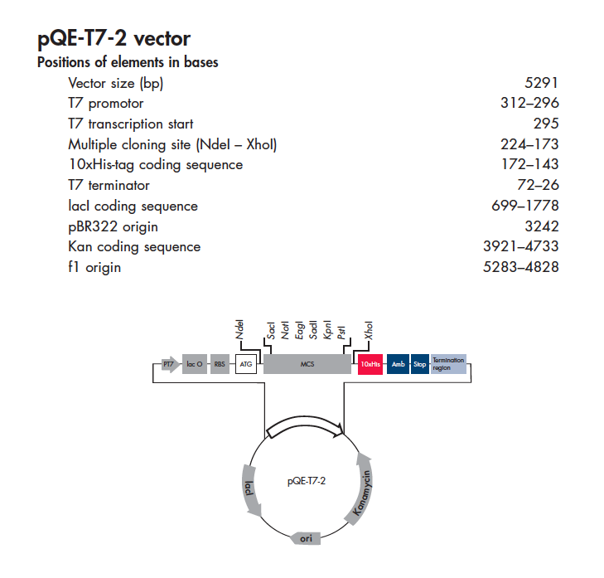

Slide 19
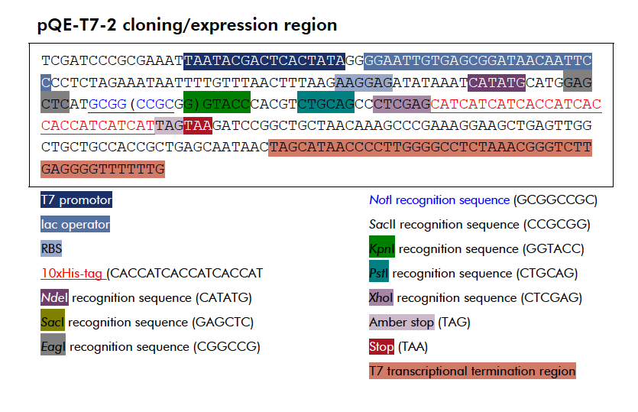

Slide 20
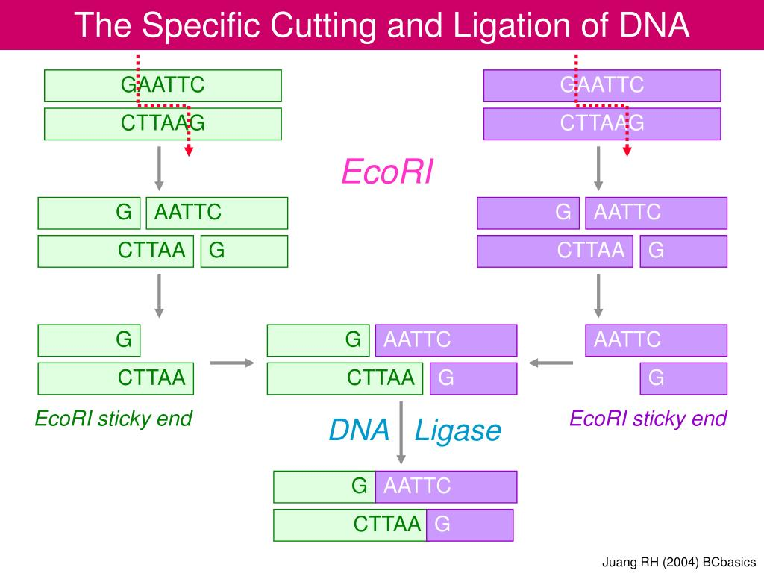
Restriction Enzymes DNA binding proteins that bind to specific DNA sequences and cut (restrict) both strands of the double stranded DNA at defined sites.
Most recognize palindromic inverted repeats – word the same forward
as backward (HannaH : RadaR ).
With DNA, easiest to see looking at both strands:
5'---GAATTC---3’ 3'---CTTAAG---5'

Slide 21
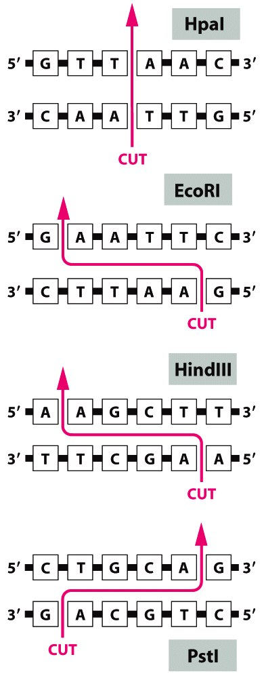
Example of 4 different restriction endonucleases showing the DNA sequence
that they recognize and bind too and also indicating where the enzymes cut the DNA (red arrow).
Note 3' ends have OH group
Blunt ends
GGT
CAA^{P}
^{P}AAC
TTG
5’ overhang
G
CTTAA^{P}
^{P}AATTC
G
5’ overhang
3’ overhang
CTGCA
G^{P}
^{P}G
ACGTC
Figure 8-31 Molecular Biology of the Cell (© Garland Science 2008)

Slide 23
AAL gene engineered for cloning into pQE-T7-2 Addition of 5’Nde I site and 3’ Xho I site. (Note: colored site indicates DNA sequence recognized and cut by the restriction endonucleases Nde I and Xho I) An Nde I - Xho I restriction digest will result in a 949 bp AAL DNA fragment
NdeI
CAT
ATG
CCTACC
GAATTCCTCTACACCTCGAAAATTGCAGCCATCTCTTGGGCTGCCAC
GCA
GC
CGGCGGCCGCCAGCAA
GTCTACTTCCAAGACCTTAATGGCAAGATCCGC
G
GCTC
AGCGCGGGGGAGACAATCCATGGACCGGCGGGTCGAGCCAGAATGTAAT
CGGCGAAGCA
GC
AAGCTTTTTTCGCCACTGGCTGCTGTCACGTGGAAAAGTGCTCAGGGCATACAGATC
T
GC
GTTTACTGCGTCAATAAGGATAACATCCTCTCC
A
TTTGTGTATGACGGTTCGAAGT
GGATCACCGGACAGCTGGGCAGTGTCGGCGTCAAGGTGGGCTCCAATTCGAAGCTTGCT
GCGCTTCAGTGGGGCGGATCTGAGAGCGCCCCCCCAAACATCCGAGTTTACTACCAGAA
GAGCAACGGT
AGTGGGAGCTCAATCCACGAGTATGTCTGGTCGGGCAAATGGACGGCTG
GCGCAAGCTTTGGGTCAACGGTGCCAGGAACGGGTATCGGAGCCACCGCCATCGGGCCA
GC
G
GC
GGTCGCCTG
ATCTACTACCAGGCTACTGACAACAAGATCCGT
G
CACTGTTGGGA
CTCCAACAGTTGGTACGTGGGGGGGTTCTCGGCCAGCGCTTCCGCCGGCGTCTCCATCG
CGGCGATTTCTTGGGGCAGTACACCCAACA
TCCGGGTCTACTGGCAGAAAGGTAGGGAG
GAATTGTACGAGGCTGCCTATGGCGGTTCATGGAACACTCCTGGTCAGATCAAGGACGC
ATCCAGGCCTACGCCCTCGTTGCCAGACACCTTTATTGCTGCGAACTCCTCGGGGAACA
TCGACATCTCTGTGTTCTTCCAA
CTCGAG
XhoI

Slide 24
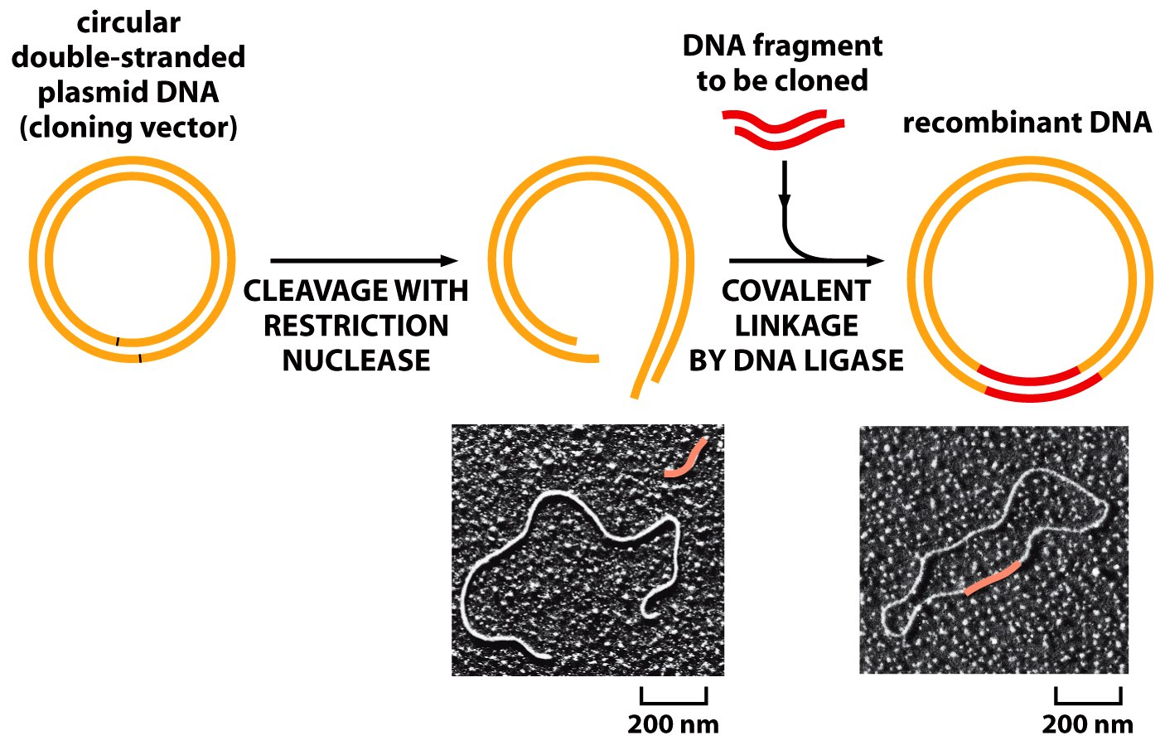
Ligation of a DNA fragment into a plasmid vector
AAL
NdeI
Xho I
pQE-T7.2
AAL-pQE
NdeI
Xho I
Figure 8-39 Molecular Biology of the Cell (© Garland Science 2008)

Slide 25
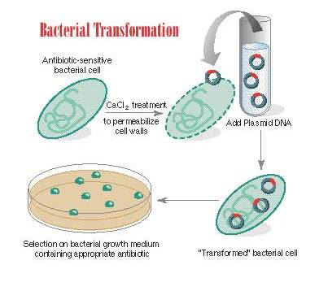

Slide 26
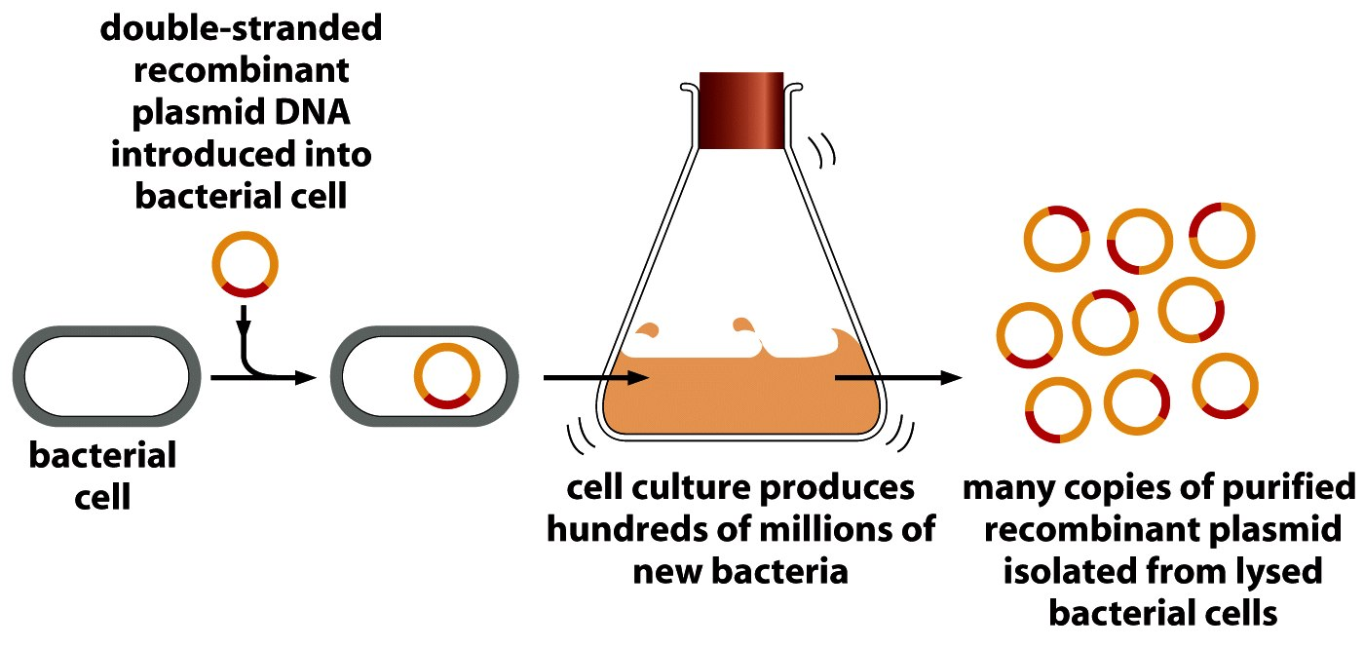
Bacterial Transformation is the procedure used to introduce the recombinant plasmid into bacterial cells to produce many copies. This allows for isolation of plasmid DNA in quantities required for subsequent analysis
Figure 8-40 Molecular Biology of the Cell (© Garland Science 2008)

Slide 27
Verify cloning procedure by restriction enzyme analysis/agarose gel electrophoresis
Gel Electrophoresis
Steps:
Pour agarose gel and let solidify
Place gel in tank and cover with appropriate electroconductive buffer
Load a DNA marker into the first well and restriction enzyme digested sample DNA into other wells
Apply an electric charge, making one end of the tank negative and the other positive
Since DNA is negative, it will travel from the cathode(-) end to the anode(+) end
Smaller DNA fragments will travel farther than larger DNA fragments
Notes:
So these are the steps that we performed:
-We loaded a DNA marker into the first well, which would basically give us a good indication of where the DNA bands would be if they had x amount of base pairs. This helped us locate our gene of interest on the gel.
Then, we loaded the cut up DNA into the second well
We applied an electric charge, making one end of the well negative and the other positive
Since DNA is negative, it will be attracted to the other positive end, and travel towards that end. The smaller DNA fragments will travel faster than the larger fragments, thus separating out by size.

Slide 28
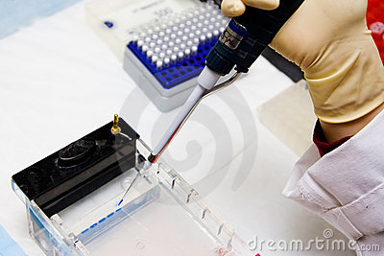

Slide 29
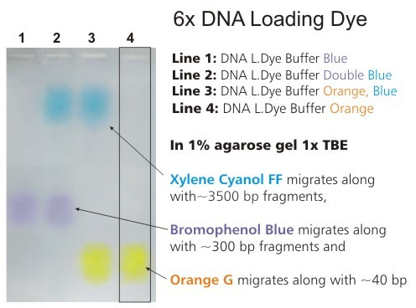

Slide 30
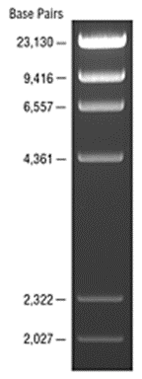
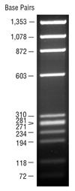
DNA Ladders
λ DNA-HindIII Digest
ΦX174 DNA-HaeIII Digest

Slide 31
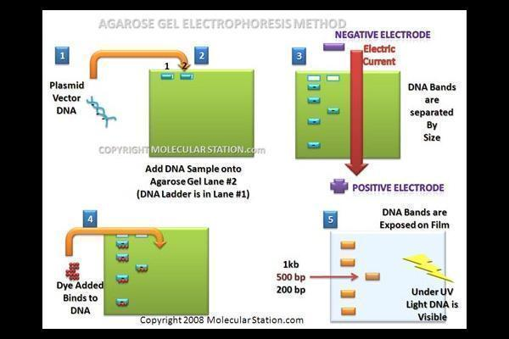
DNA Agarose Gel Electrophoresis
Cathode
Anode
Notes:
So just to resummarize, if this (point) is where the wells are, then this end would be negative. The other end (points) would be positive. DNA would travel from the negative end ot the positive end.

Slide 32
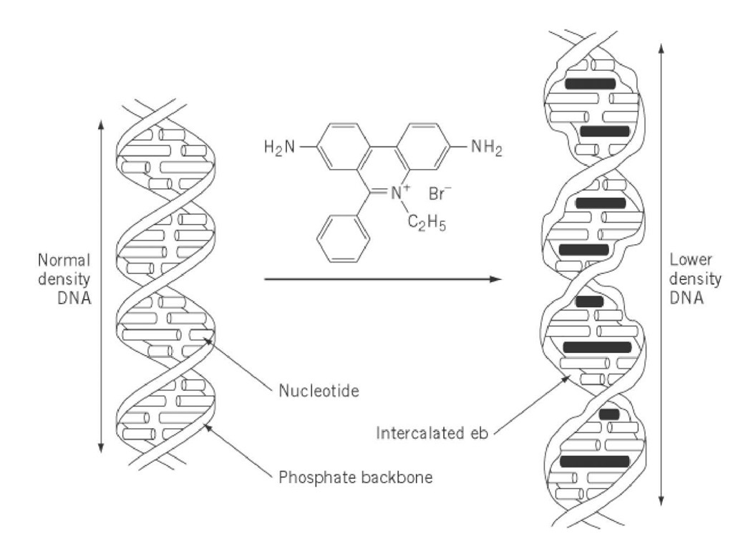
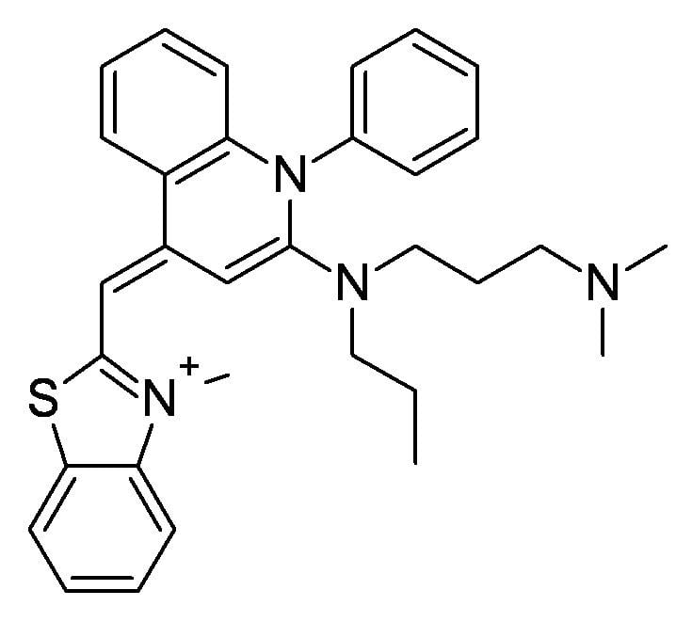
SYBR Green
Intercalated SYBR Green

Slide 33
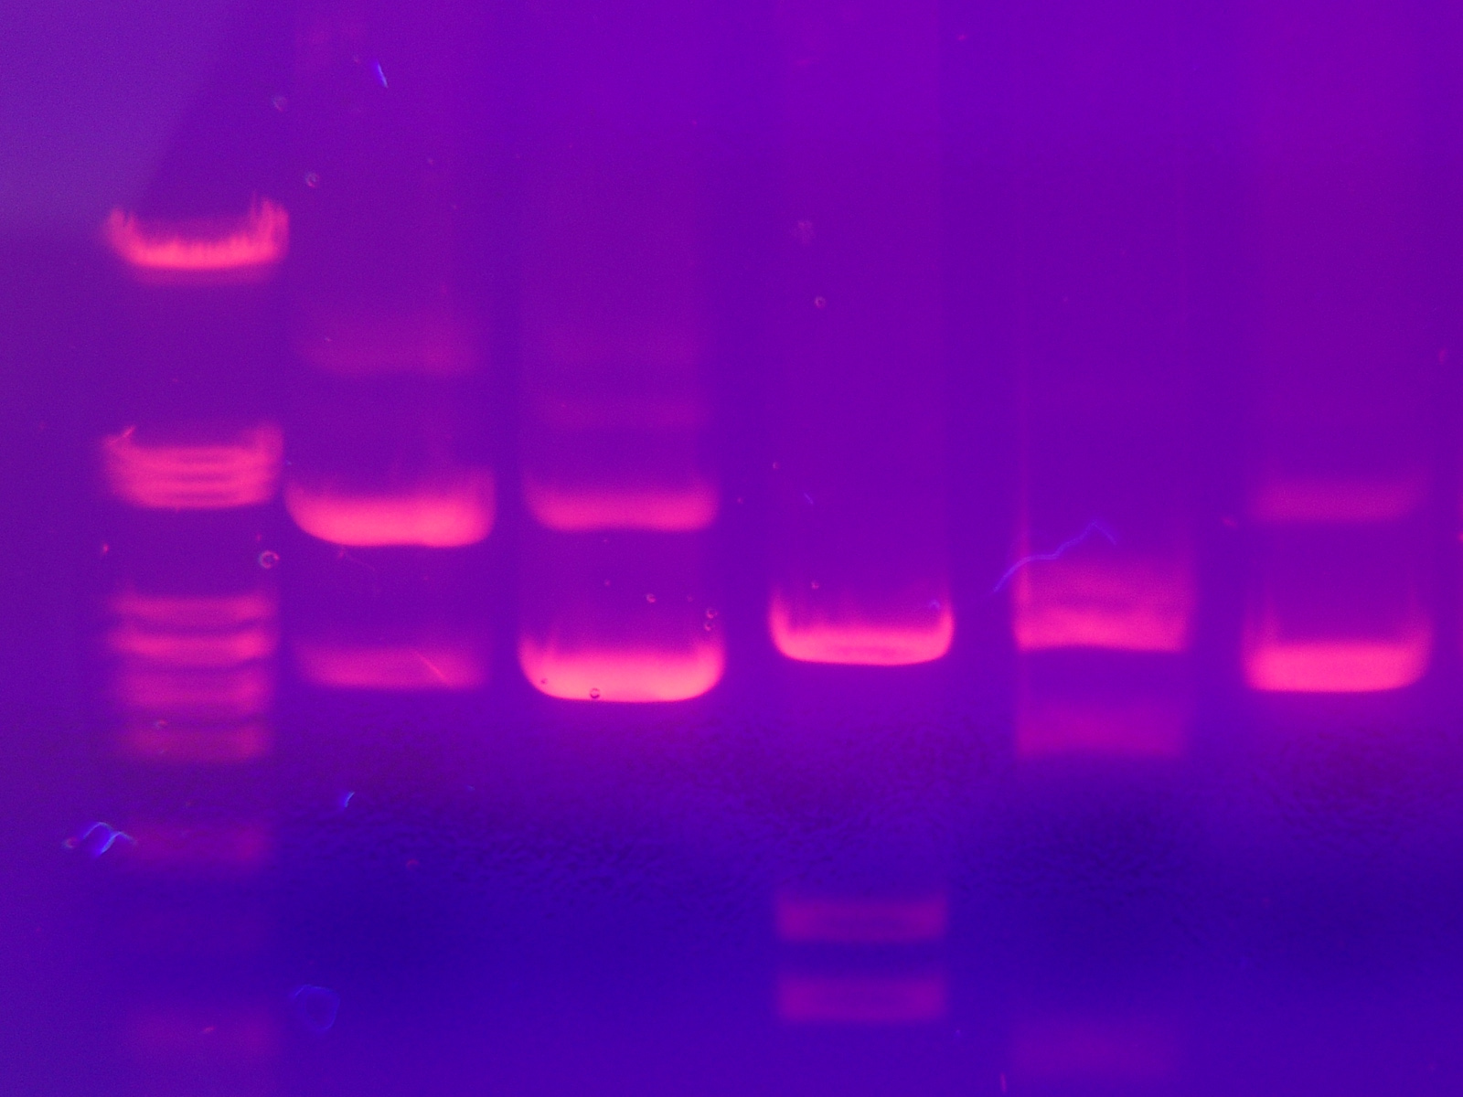
Agarose Gel Electrophoresis of DNA
Cathode
Anode
DNA samples were fractionated (separated) by size
on a 1% agarose gel containing SYBR Green.
SYBR Green intercalates into the double stranded DNA helix.
When exposed to laser light, SYBR Green fluoresces
allowing visualization of the DNA fragments
Notes:
Okay, so although this picture was not from our experiment, I still think it is a good example of what a DNA gel electrophoresis looks like. As you can see, the DNA is separated out in bands. The bands that travel farther (points) are smaller in size. The bands that lagged behind (points) are larger in size.

Slide 34
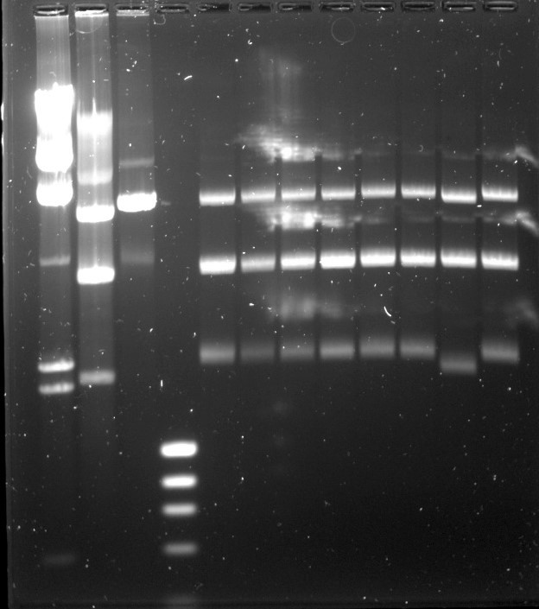
Diagnostic Restriction Enzyme DNA Digests of 8 Ligation Reaction Transformants
φX174/HaeIII
Vector
λ/HindIII
Vector
1 2 3 4 5 6 7 8
Cathode
Anode

Slide 35
STEP 2:Induced expression of recombinant AAL
Recombinant plasmid is introduced into BL21 bacterial cells. Plasmid copy number amplifies as cells grow.
Bacteria are induced to express recombinant
AAL protein to high levels
Figure 8-40 Molecular Biology of the Cell (© Garland Science 2008)

Slide 36
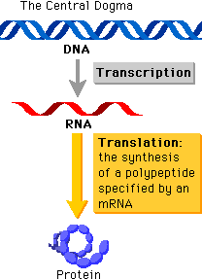
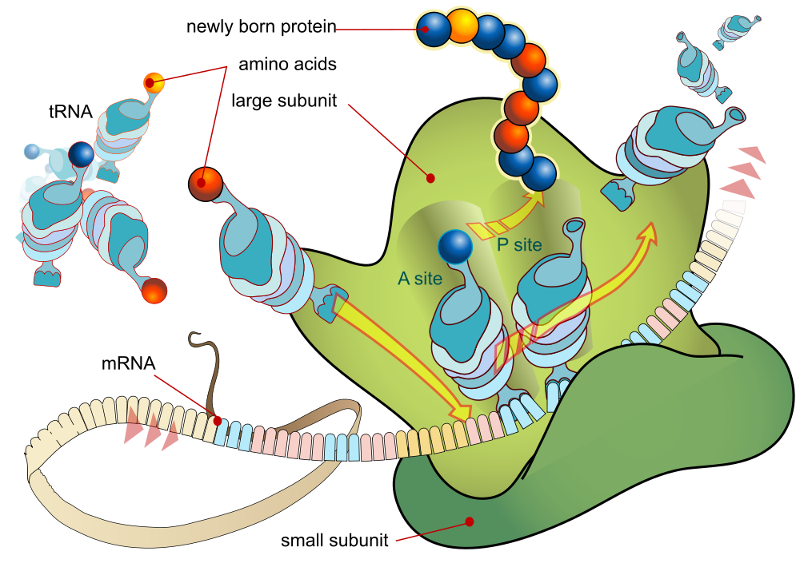

( ~19 – 20,000 protein coding genes; makes up only ~ 2% of the human genome)
Ribosome

Slide 37


BL21 bacterial expression system
AAL Gene
rAAL Protein
(Molecular weight ~36 kDa)

Slide 38
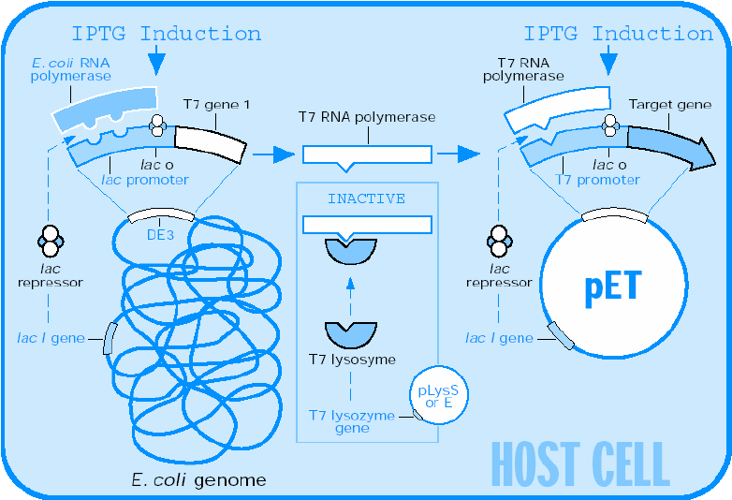
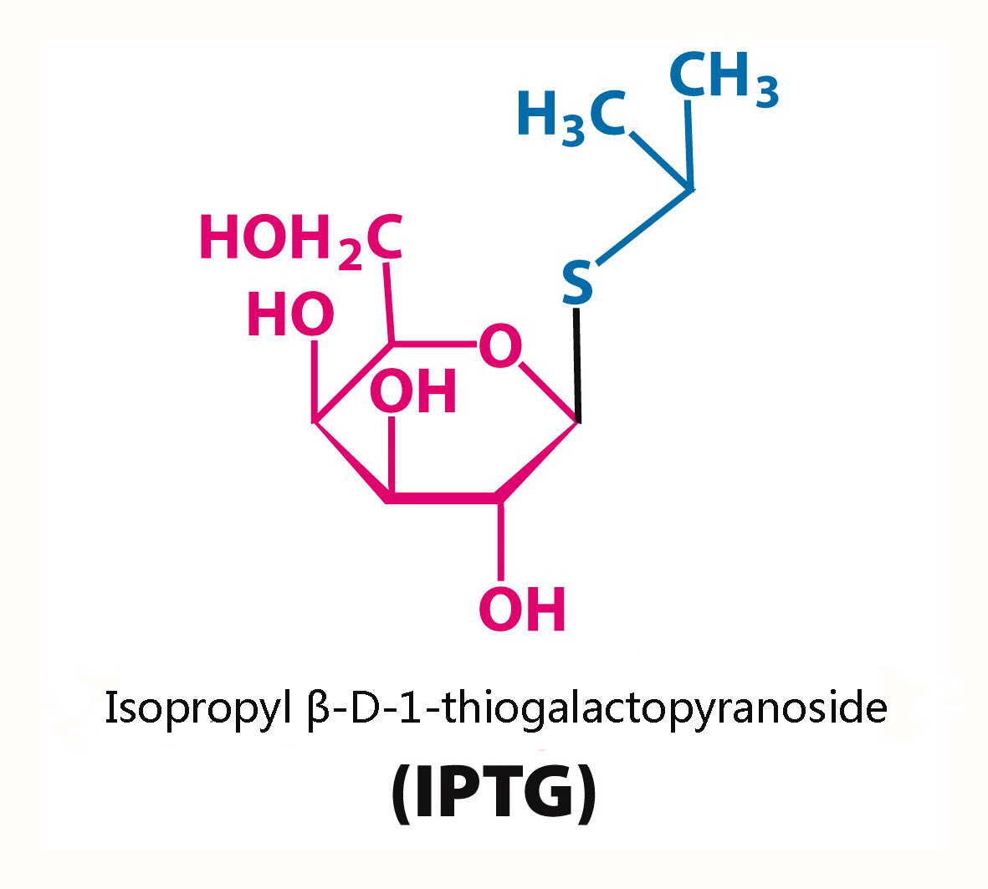
T7 Induced bacterial expression system (IPTG-dissociates the lac repressor to initiate gene expression)
AAL gene
pQE-T7.2

Slide 39
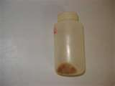
STEP 3: Protein extraction and purification
Pellet bacterial cells from culture

Slide 40
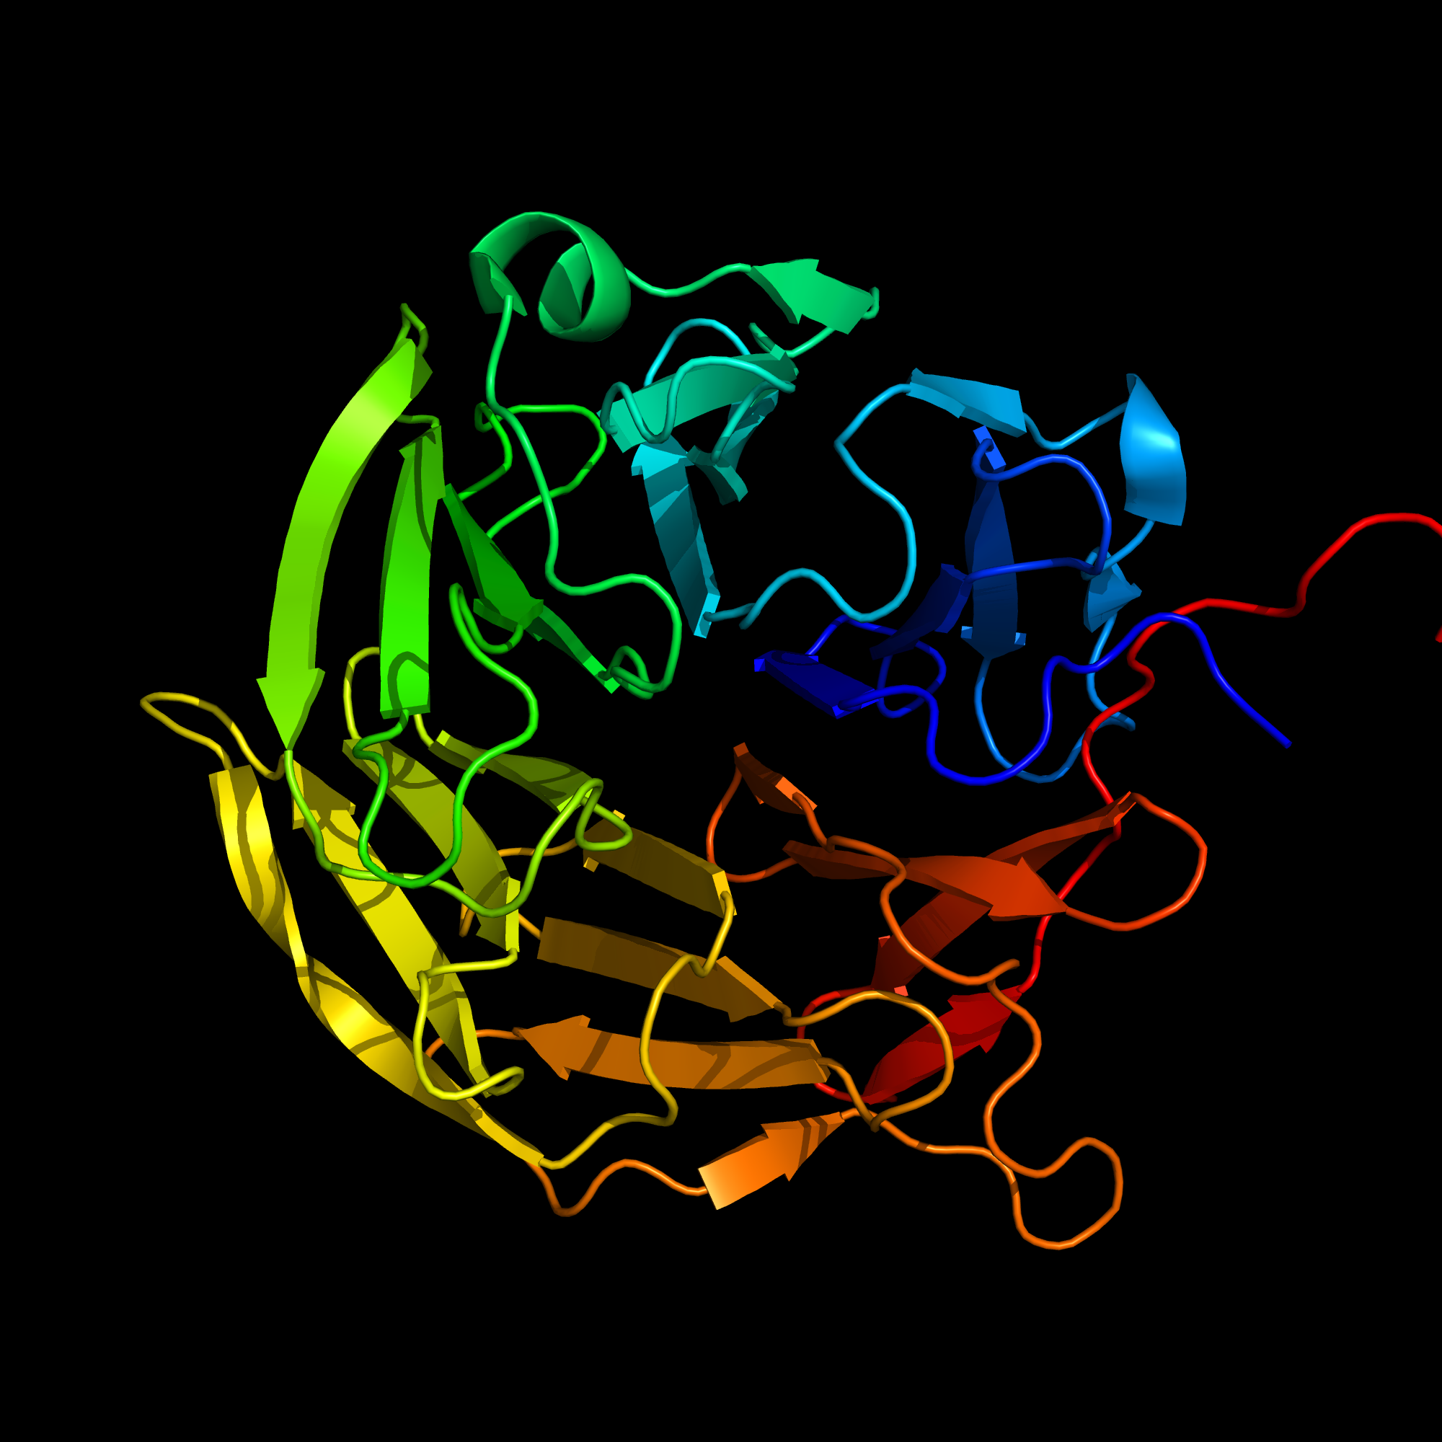
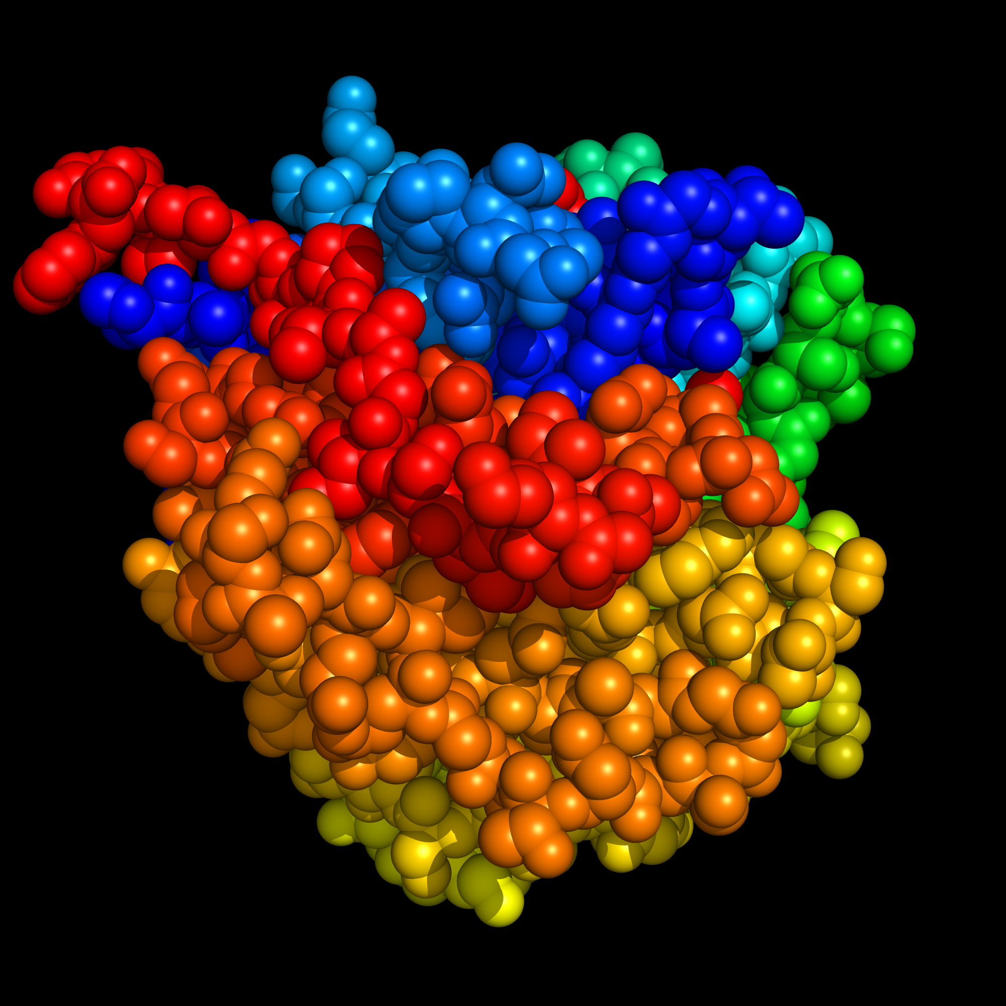
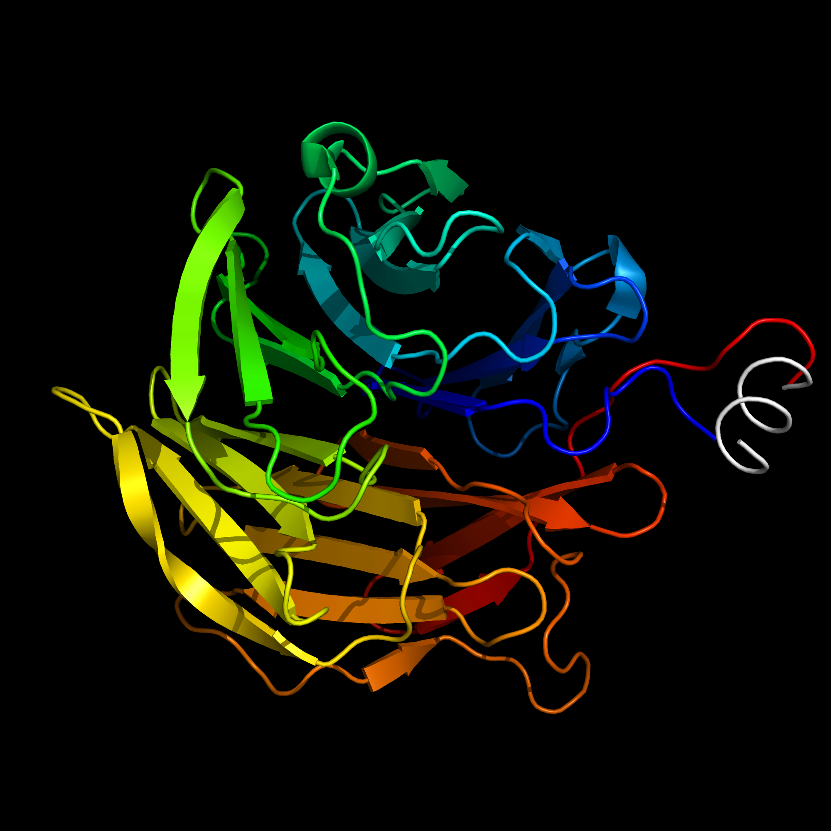
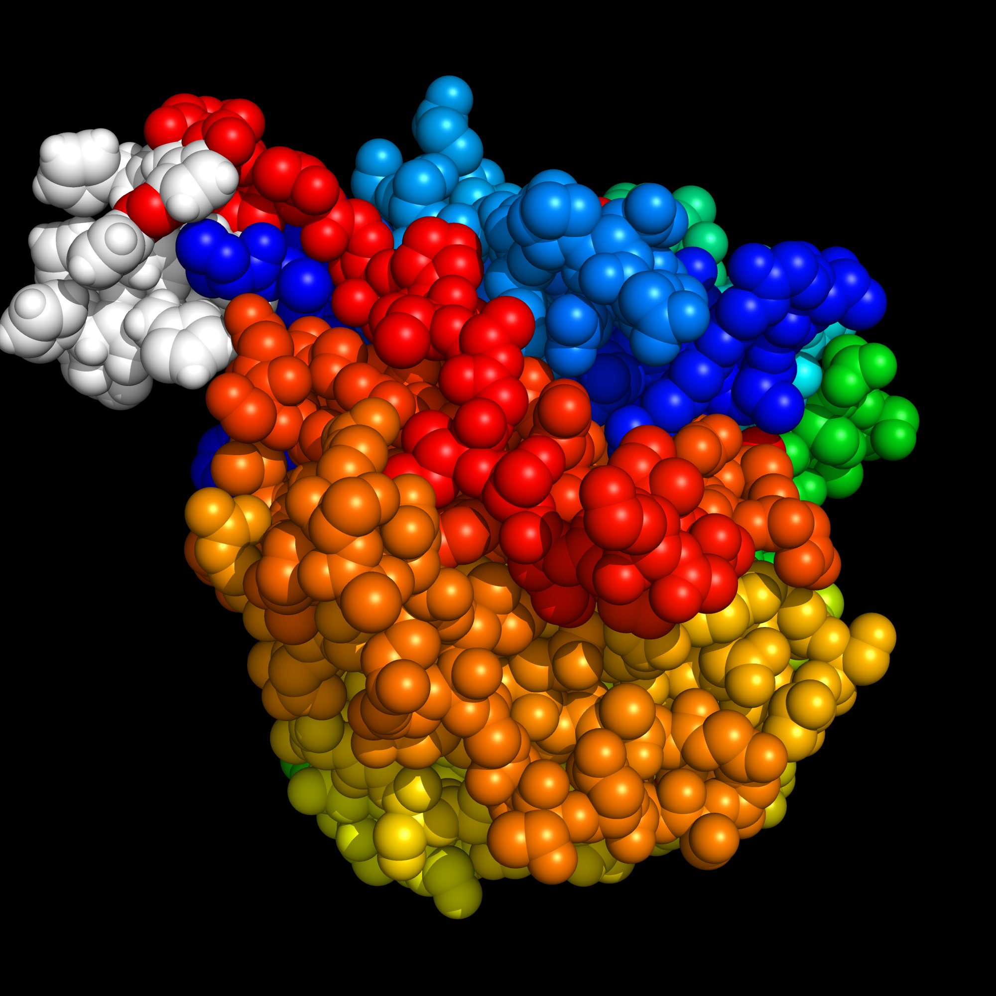
AAL monomer with 10X poly-His tail
No Histidine Tag
10X Histidine Tag

Slide 41
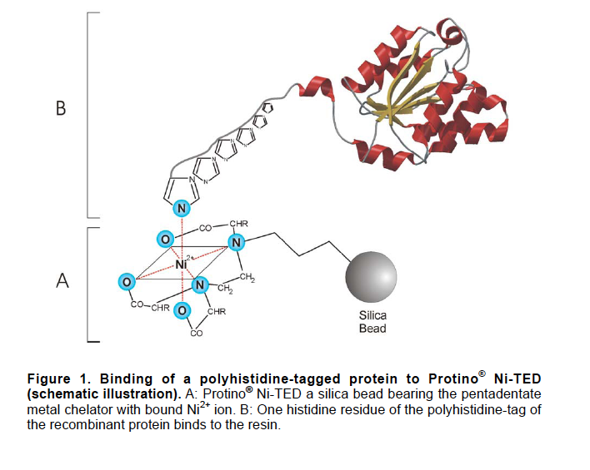
IMAC Purification of recombinant His tagged AAL protein (note: amino acid histidine (His) binds to nickel ions)
Histidine tag
rAAL protein

Slide 42
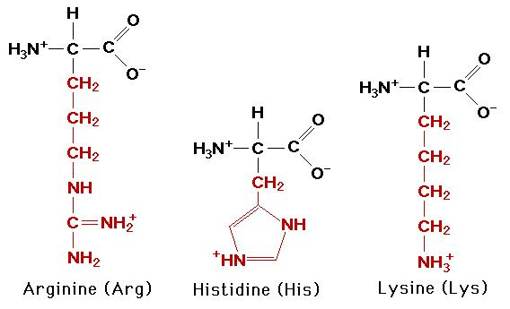
Basic Amino Acids

Slide 43
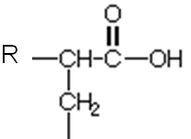
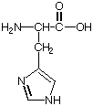
Addition of high concentrations of the chemical imidazole displaces the histidine tag from the nickel beads and elutes the rAAL protein by mass action
Histidine tag on rAAL protein
Nickel
Imidazole

Slide 44
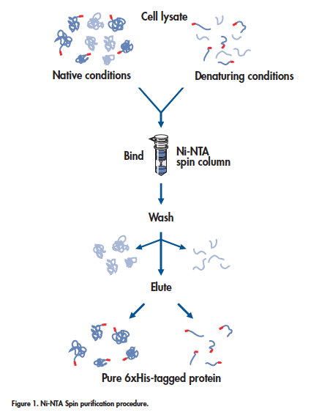
Procedure for purifying His-tagged (RED dots) proteins
from bacterial cell lysate using Ni-NTA spin columns
Low imidazole buffer
High imidazole buffer
Purified His-tagged rAAL

Slide 45
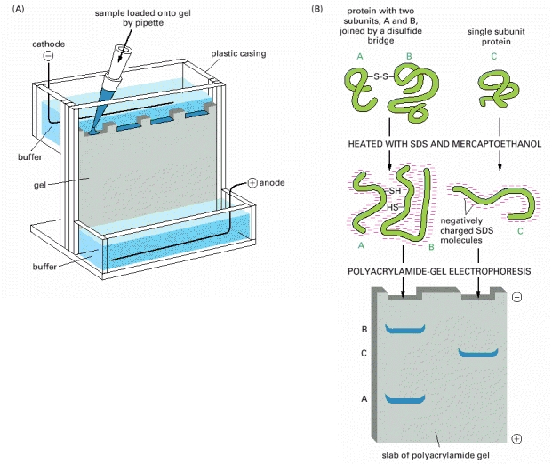
Evaluate rAAL fractionation using SDS-PAGE analysis (Poly Acrylamide Gel Electrophoresis)
Cathode
Proteins are separated based on size, smaller
proteins migrating more quickly towards the anode.
To visualize proteins the gel is soaked in the dye
Coomassie blue which binds to amino acids in the protein
Anode

Slide 46
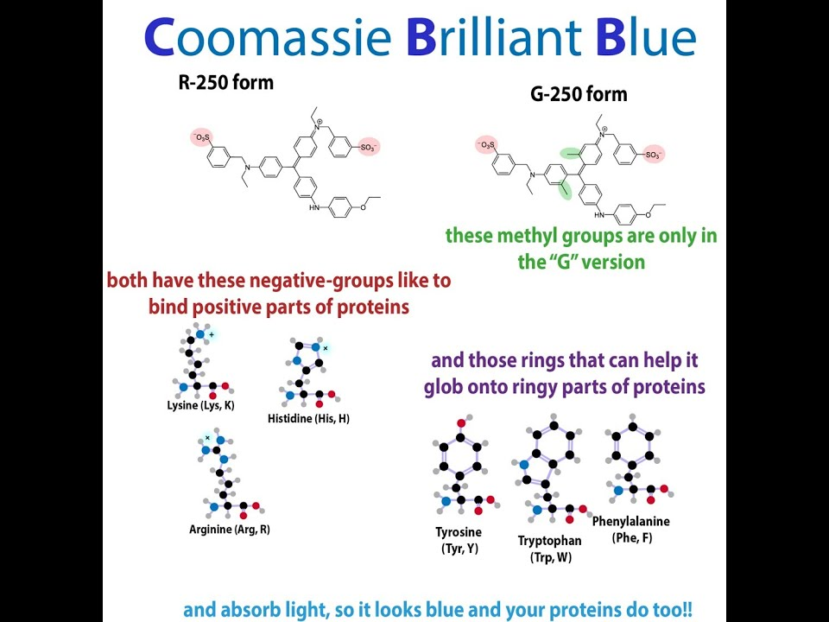

Slide 47
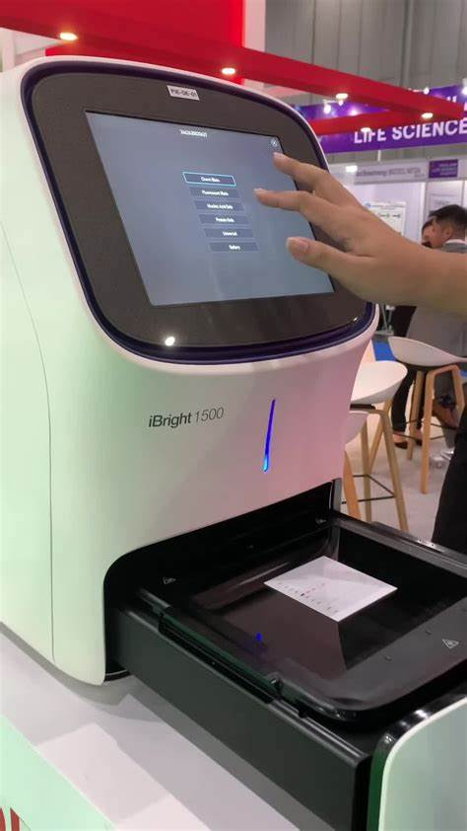
Visualizing coomassie stained protein gel
Place gel and water onto platform of the iBright 1500 Imager
Scans an image of the gel onto the computer

Slide 48
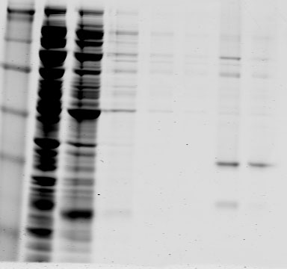
Results from 2010 students SDS-PAGE analysis of AAL fractionation over Ni-NTA columns. E1-E2 are the elution fractions. Gel was stained and proteins visualized with Coomassie blue
W2
E1
E2
FT
W1
W3
W4
Cathode
98kDa
64kDa
50kDa
36kDa
AAL
Anode
Success
Other proteins present – could be improved (but not bad!)

Slide 49


AAL N224Q Use in Diagnostic Assay for Liver Disease and Cancer
N224Q AAL-10X His
AFP L3: Core fucosylation (α1-6 linkage)

Slide 50
rAALs have higher binding affinity for core fucose targets as compared to the commercial lectin
BSA
Lectin
AFP
TSM Sensor

